Slide 1
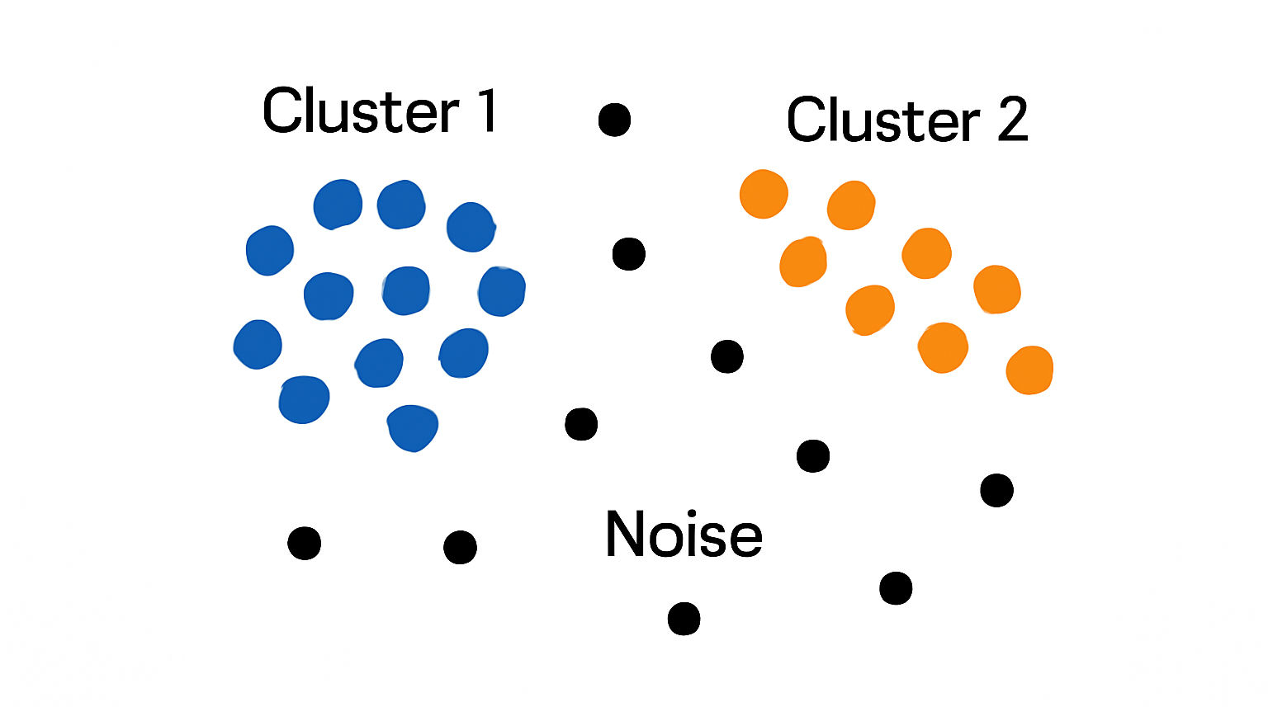
DBSCAN Clustering
Density-Based Spatial Clustering of Applications with Noise

Slide 2


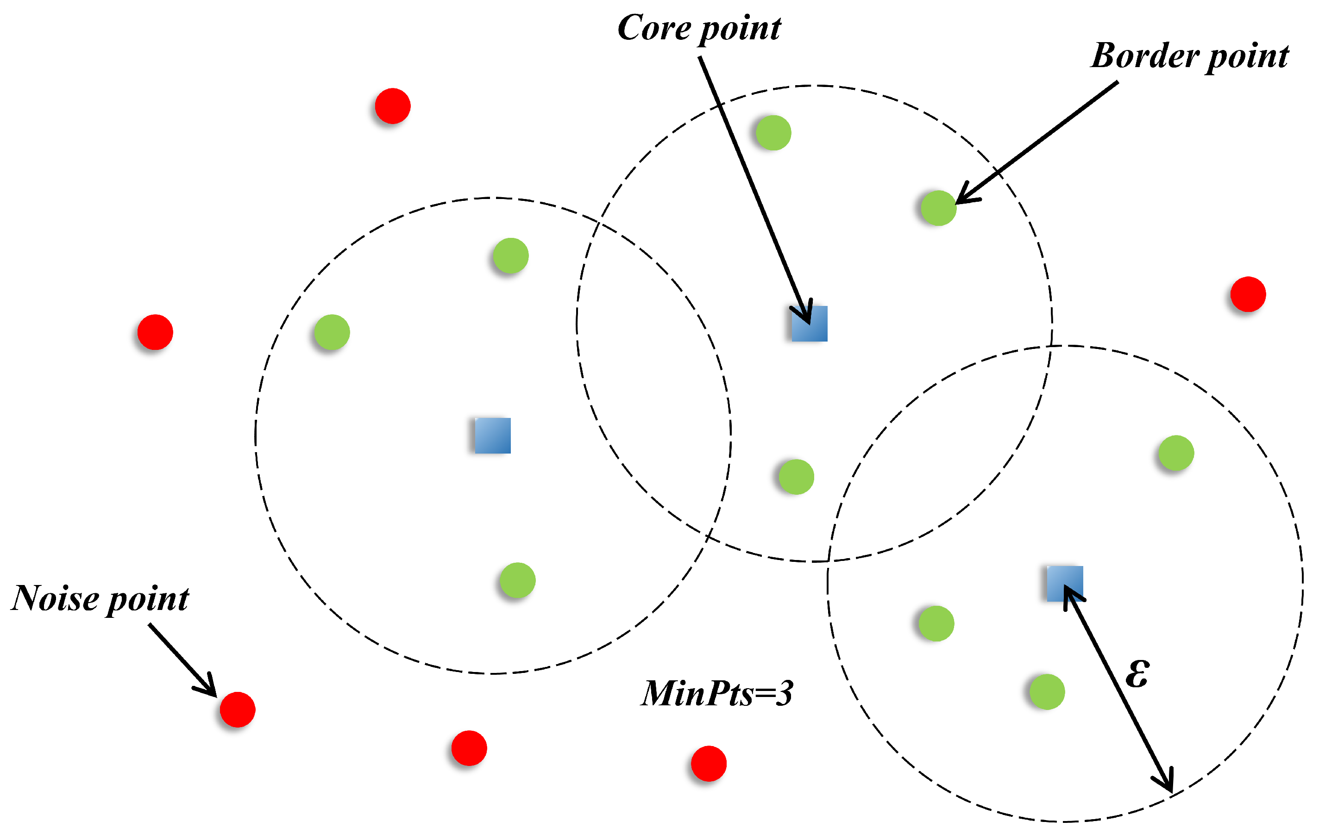
DBSCAN is an unsupervised machine learning algorithm that groups together data points in dense regions, identifying clusters of arbitrary shapes while effectively handling outliers.
How DBSCAN Works?
DBSCAN works based on the concept of Core Points, Border Points, and Noise Points.
Core Points → A data point is a core point if it has at least min_samples neighbors within a distance of eps.
Border Points → A data point that is not a core point, but lies within the neighborhood of a core point.
Noise Points (Outliers) → Points that are neither core points nor border points.

Slide 3
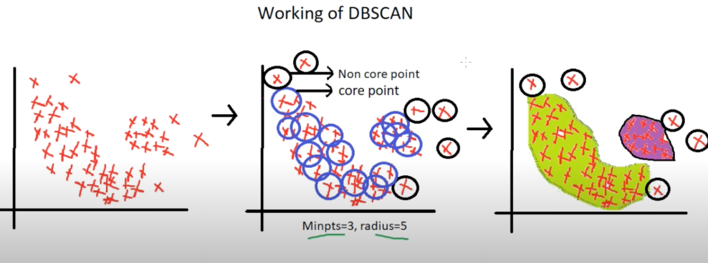
Step-by-Step DBSCAN Working
Step 1: Plot the data points
First, we plot all the data points on a graph (scatter plot).
Step 2: Define Parameters (eps and MinPts)
Example: eps = 5, MinPts = 3.
The algorithm draws a circle of radius eps around each data point.
If at least MinPts points (including itself) lie inside the circle → it is a Core Point.
If fewer than MinPts points are inside → it is a Non-Core Point (could later become a Border Point or Noise).
Example: A point marked X inside a black circle may not have enough neighbours, so it is a Non-Core Point.

Slide 4
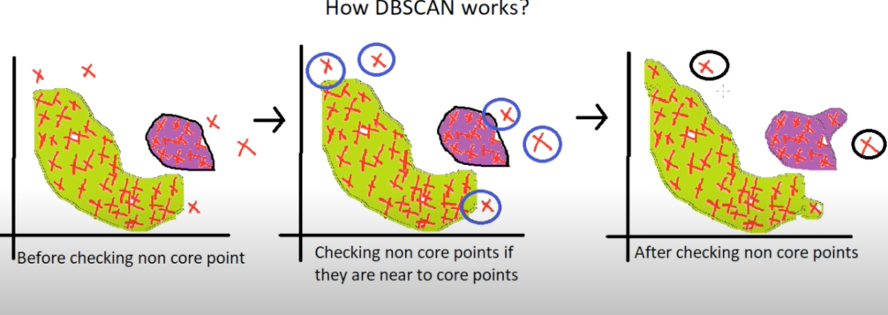
Step 3: Cluster Formation
Starting from a Core Point, DBSCAN expands the cluster by including all points within its neighbourhood.
This expansion continues recursively to nearby Core Points.
Non-Core Points that are close to Core Points are added as Border Points.
Step 4: Handling Outliers (Noise Points)
Points that do not belong to any cluster (too far from Core Points) are marked as Outliers (Noise).
These outliers are shown as scattered points (e.g., black circles outside clusters).
Important:
The quality of clusters depends on the choice of eps (radius).
If eps is too small → many points become noise.
If eps is too large → clusters may merge incorrectly.

Slide 5
from sklearn.cluster import dbscan dbscan = dbscan(eps=2, min_samples=5).fit(X) Y_dbscan = dbscan.fit_predict(X)
Advantages
Arbitrary Shape Clusters
Noise and Outlier Handling
No Predefined Number of Clusters
Disadvantages
Sensitivity to Hyperparameters
Inability to Handle Varying Densities
High-Dimensional Data Issues
Computational Cost
Uses
Geographic data analysis
Anomaly detection
Customer segmentation
Image segmentation

